Slide 1
DATA PROCESSING PIPELINE
5-Steps of Feature Engineering for Music Recommendation Engine
1
2
3
4
5
Artist + Track Data
Process Song DB
Songs Data
Genre Data
Lyrics BoW
Original data set provided by GreatLearning Team as input
Add Track ID and Artist data from SQLite track_metadata.db
Add genre data to songs provided by TU Wien Informatics
MusicXMatch dataset containing a list of the 5000 words the most used in the songs in Bag of Word format
Handle missing values
Handle null
Handle duplicates
Drop unimportant features

Slide 2
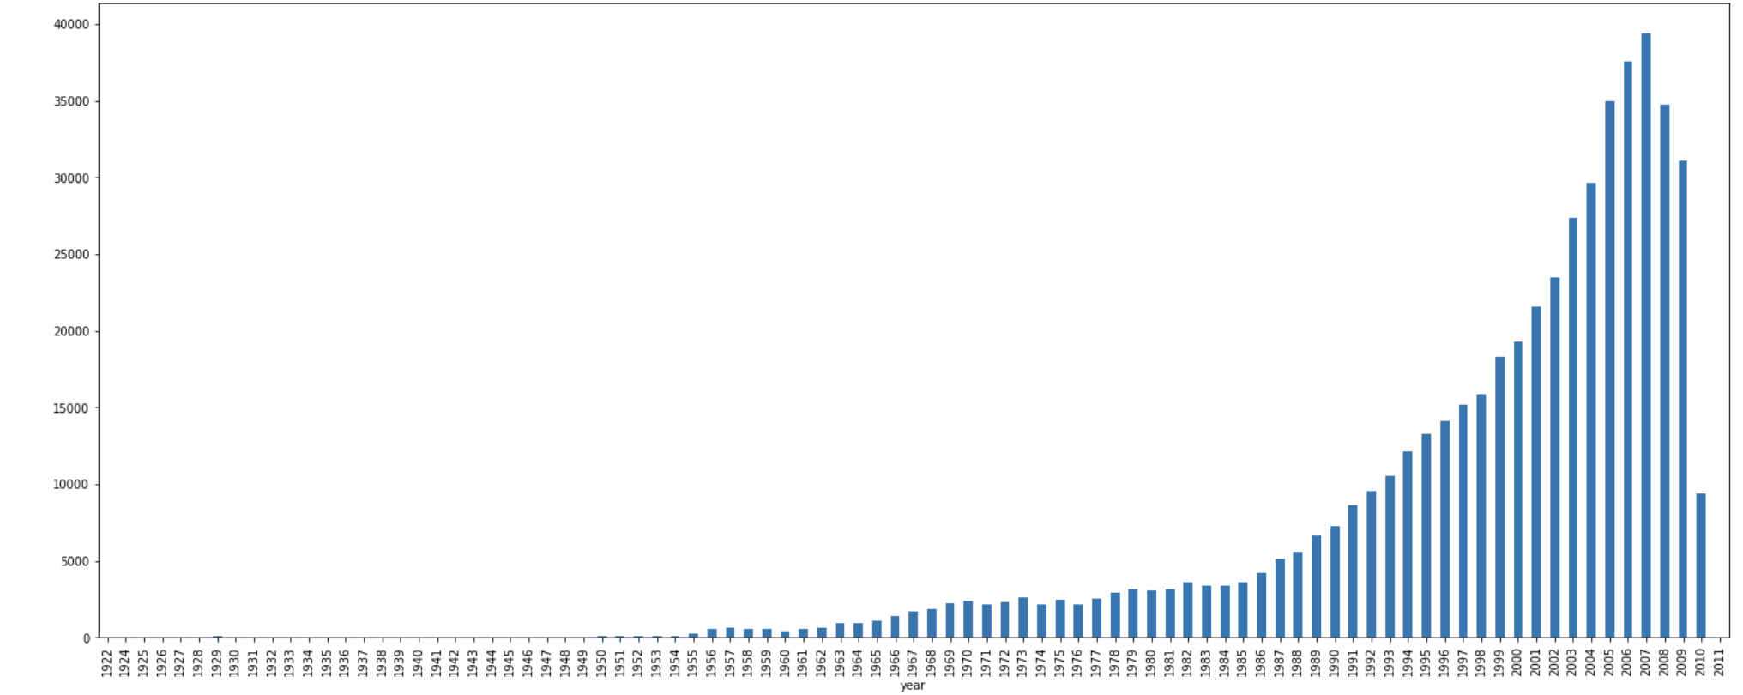
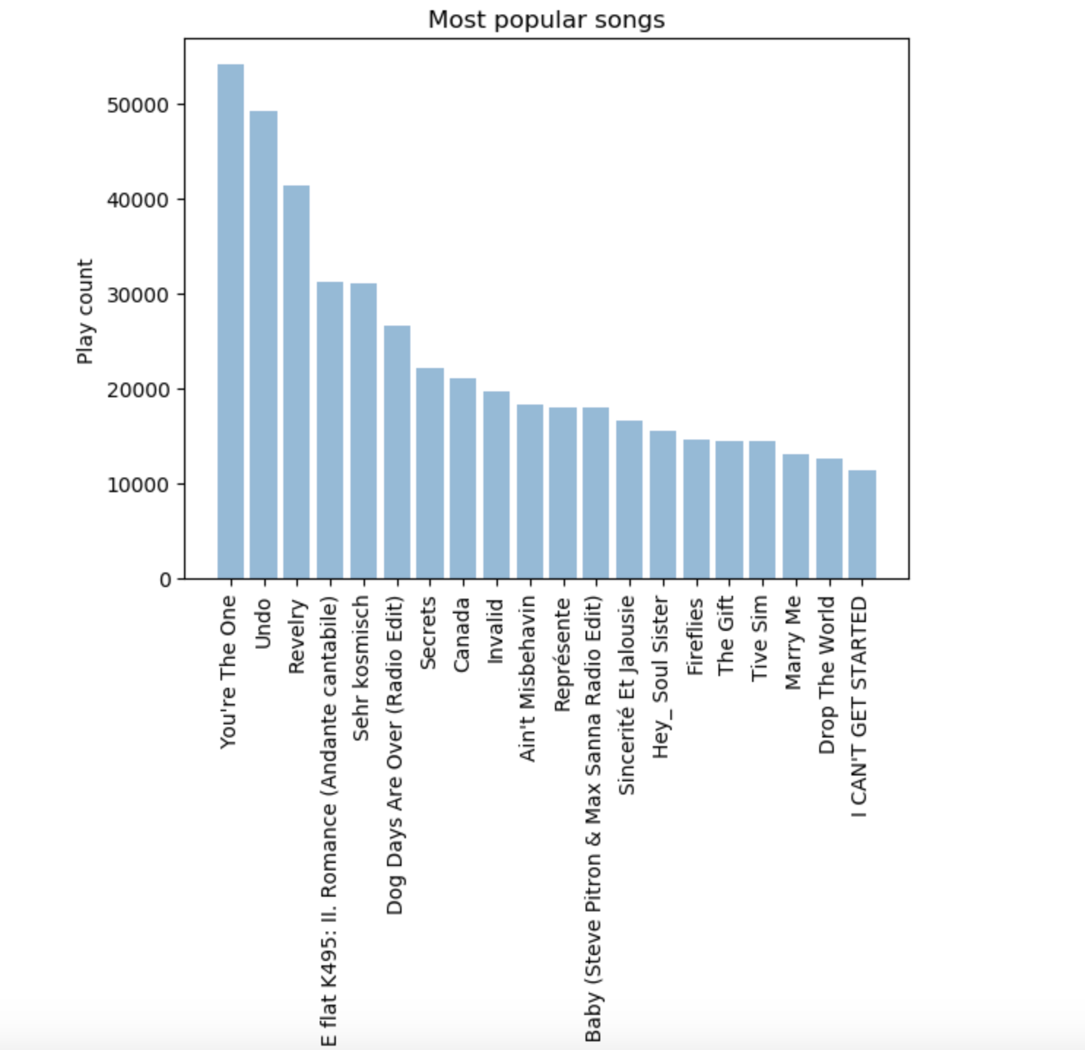
Number of Songs per year

Slide 3
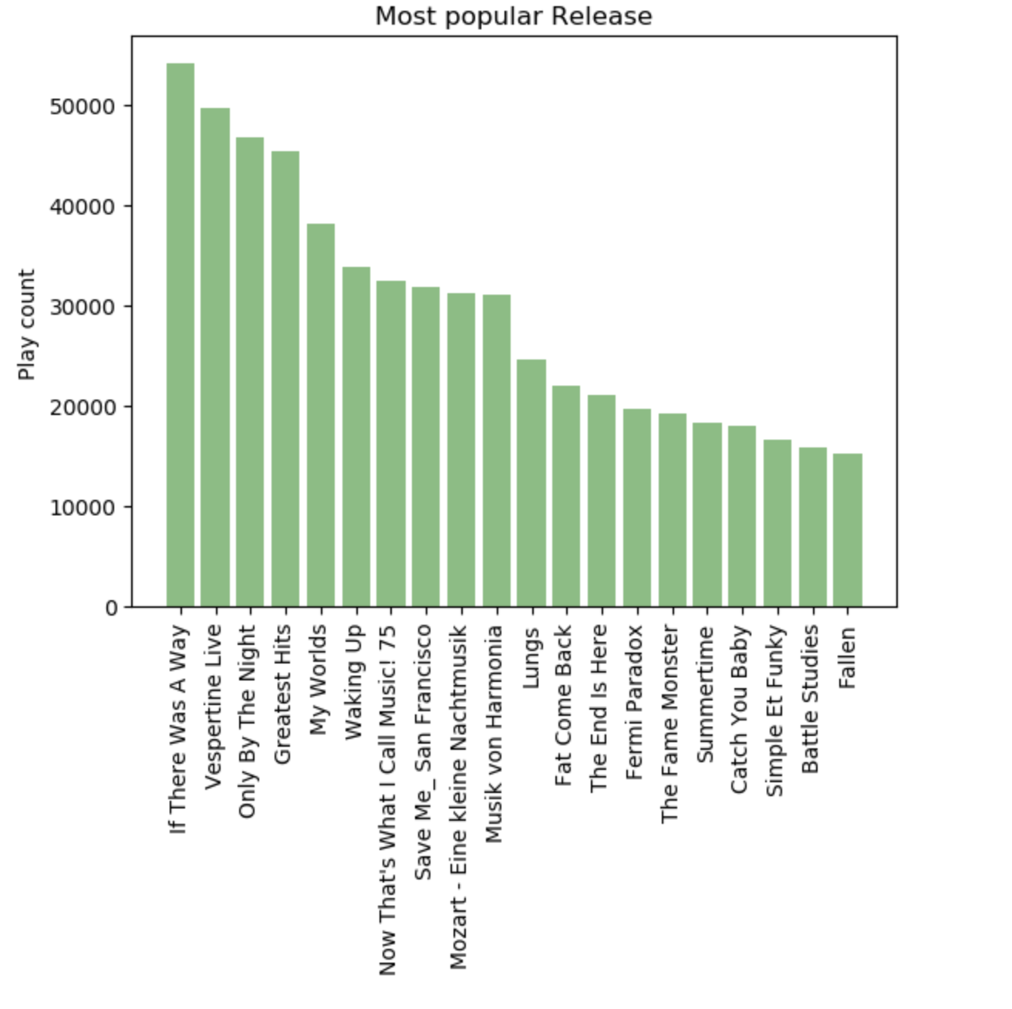
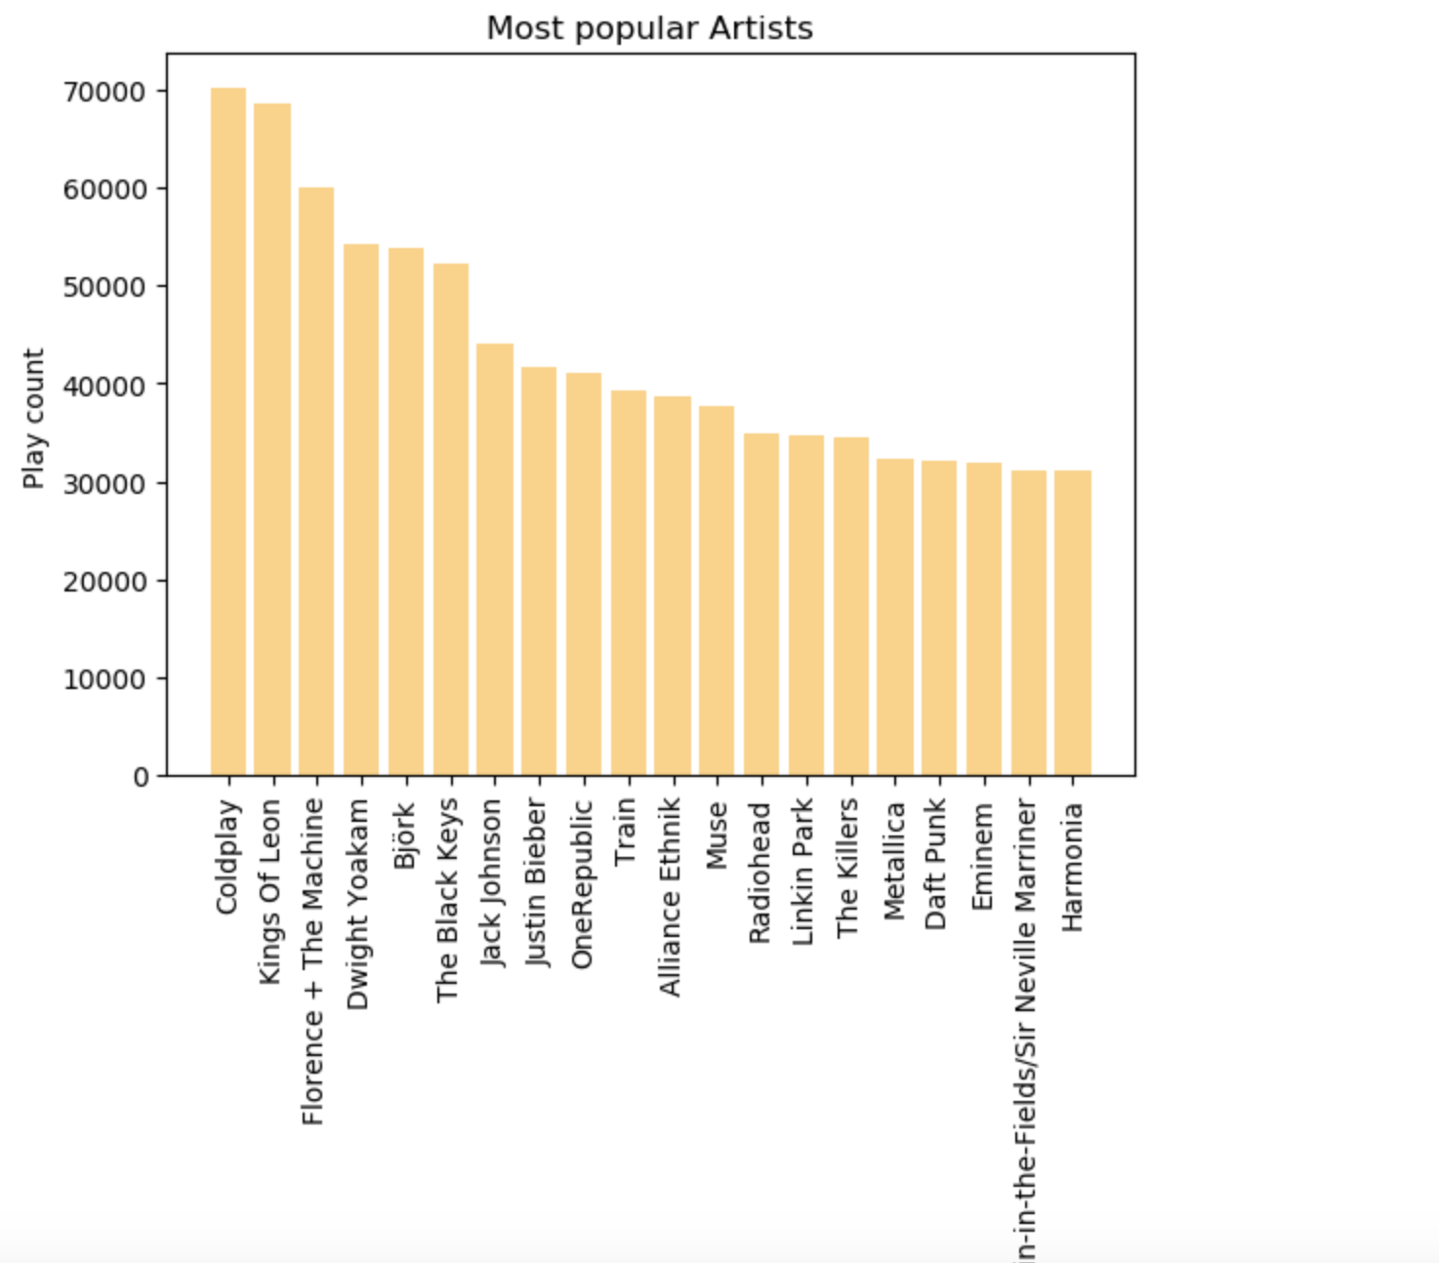

Slide 4
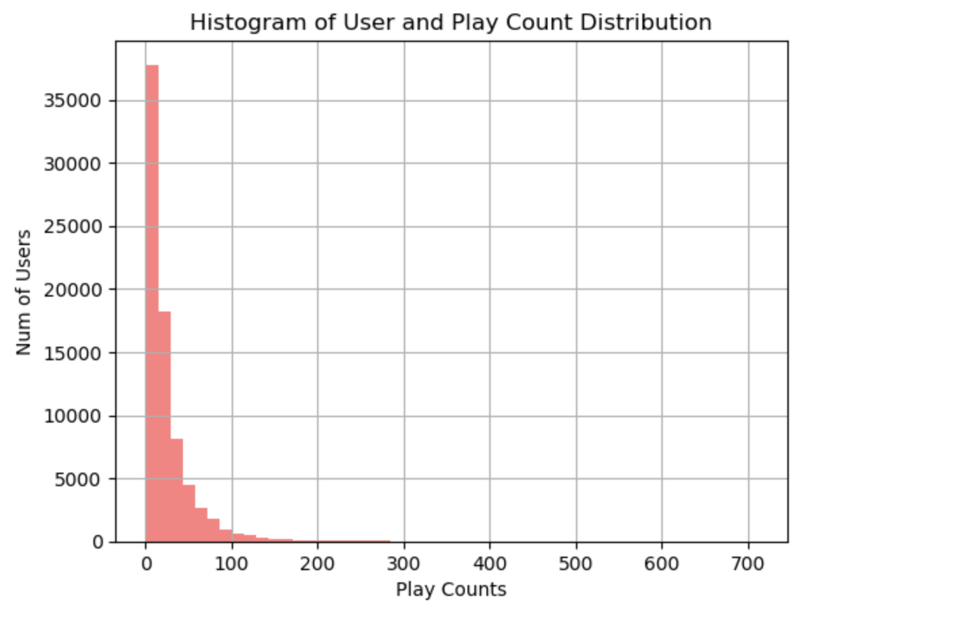
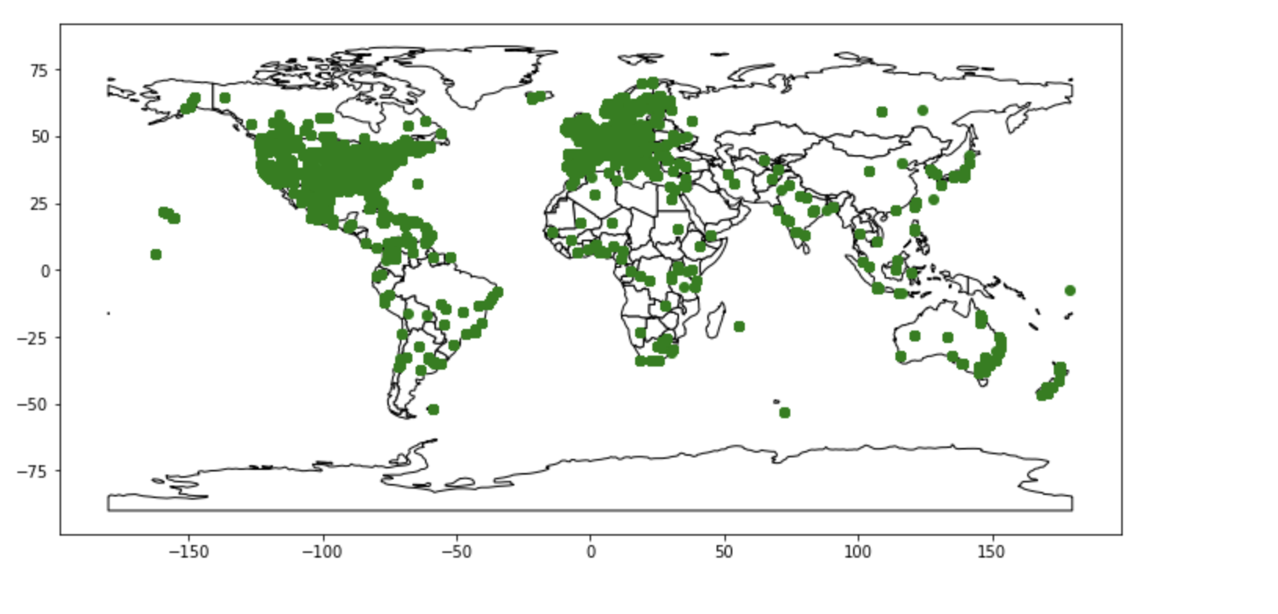
Artist distribution by geography

Slide 5
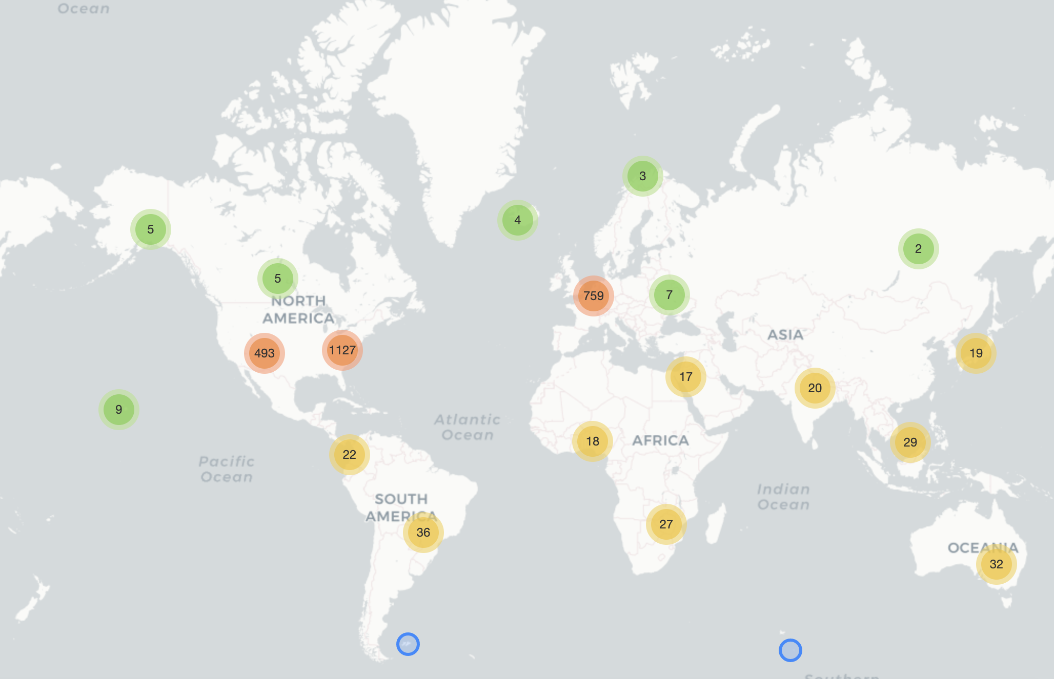
How songs are recorded across the world?
The drill-in world map allows us to visualize how songs are recorded across the world.
You can drill in to identify that there are –
82 songs recorded in Mumbai,
36 songs in Pune,
139 songs in Chennai
29 in Karnataka etc.

Slide 6

01
Create rating matrix - used implicit user Feedback and mean mean-centering
Item Similarity Based Model
Solution
02
List 1-3 ways your company proposes to solve them.
Computing the Distance Between songs using cosine similarity
calculating similarities between a
user’s items and the other items in our dataset
03
Finding Top N Song Recommendations using the nearest N songs for the given Song being listen by the user

Slide 7

01
User-Song taste - Derive and normalize Implicit Rating
Latent Factors Model
Solution
02
List 1-3 ways your company proposes to solve them.
Matrix factorization using Singular value decomposition (SVD) to obtain U, S, and V matrices. Reduce S to 50 latent factors.
Leverage the power of matrix factorization to deal with sparsity in user taste profile subset.
03
Use truncated resultant matrix U*St and S t*V for prediction or recommendations

